Slide 1
Capstone Project
NorthWind

Slide 2
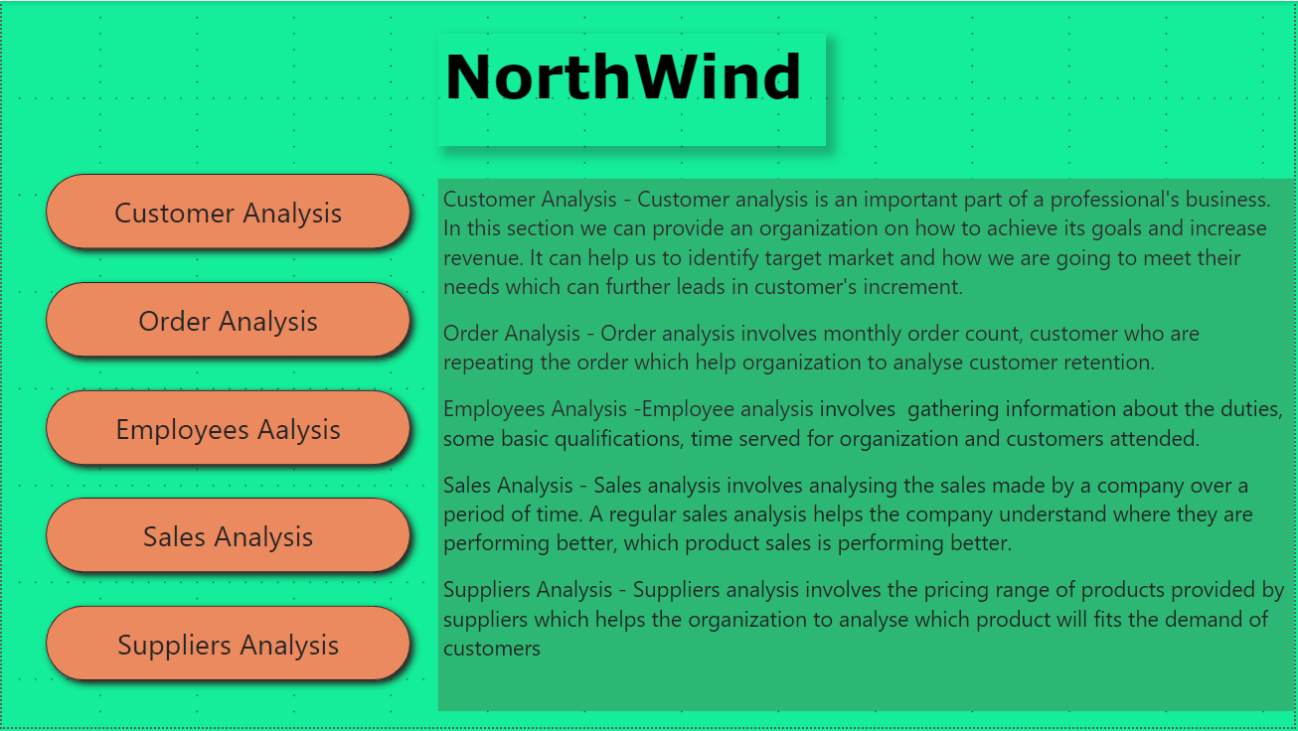

Slide 3
Overview
The objective of this project is to create an effective dashboard with the help of Power BI using the problem statements and data given to us.
To find the insights of the problem statements which helps the viewers to have a better view of the analysis.
We have done various analysis like customer analysis, sales analysis, and product analysis which provide a better understanding of the charts made.

Slide 4
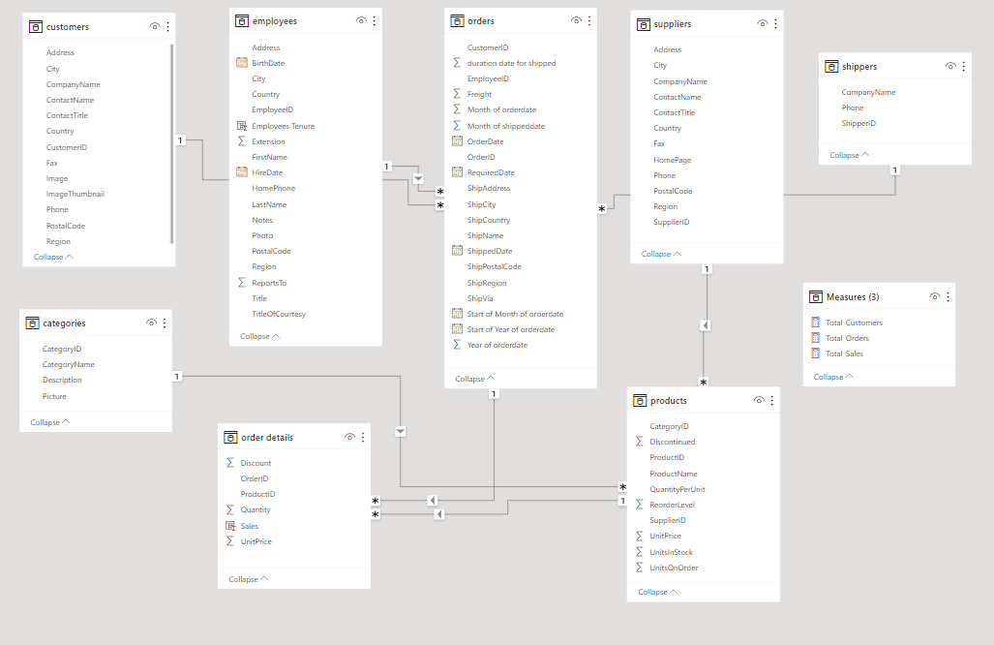
ER Diagram

Slide 5
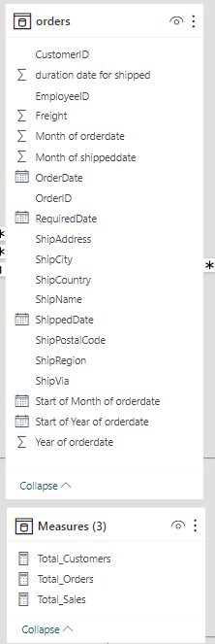
Many Problem Statements require measures to find the answers. So, we have created a measure table and calculated columns.

Slide 6
Power Bi Problem Statements

Slide 7
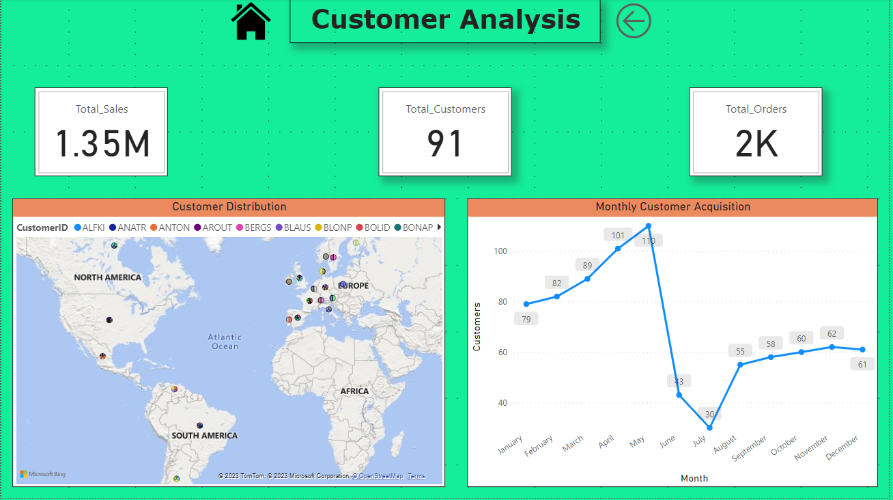

Slide 8
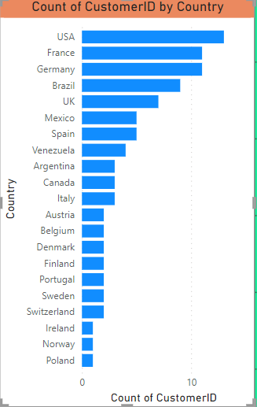
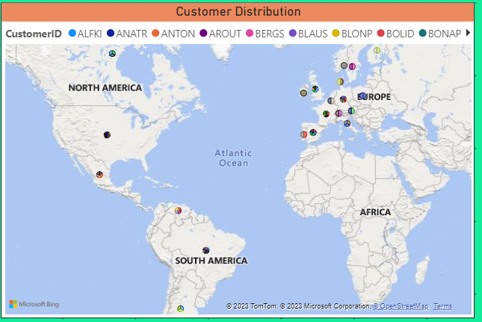
How does customer distribution vary across different regions or customer segments?
From this visualization, we come to know that Europe has the most numbers of customers compared with South America and North America.

Slide 9
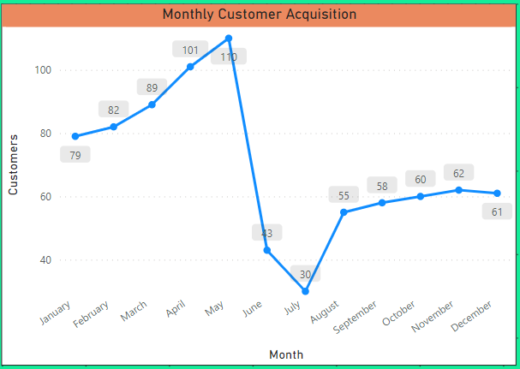
What is the trend in customer acquisition over time?
From this visualization, we can see customer acquisition over each month. We also came to know that from January till May Customers have been increasing and after that they decreased drastically.
May has the most number of customer acquisitions (110) whereas July has the least (30).

Slide 10
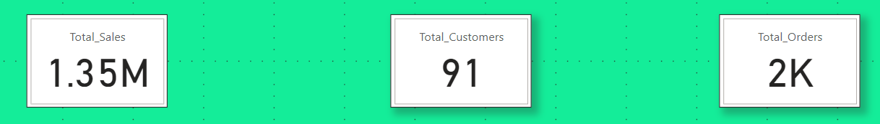
Can we visualize the distribution of customer demographics such as age, gender, or income?
Can we find the KPI related to customers?
As we can see in this visualization total sales done by the company is 1.35M, customers are near about 91 and orders completed are 2K.
We don’t have relevant data in our data set, we require age, gender and income related data.

Slide 11
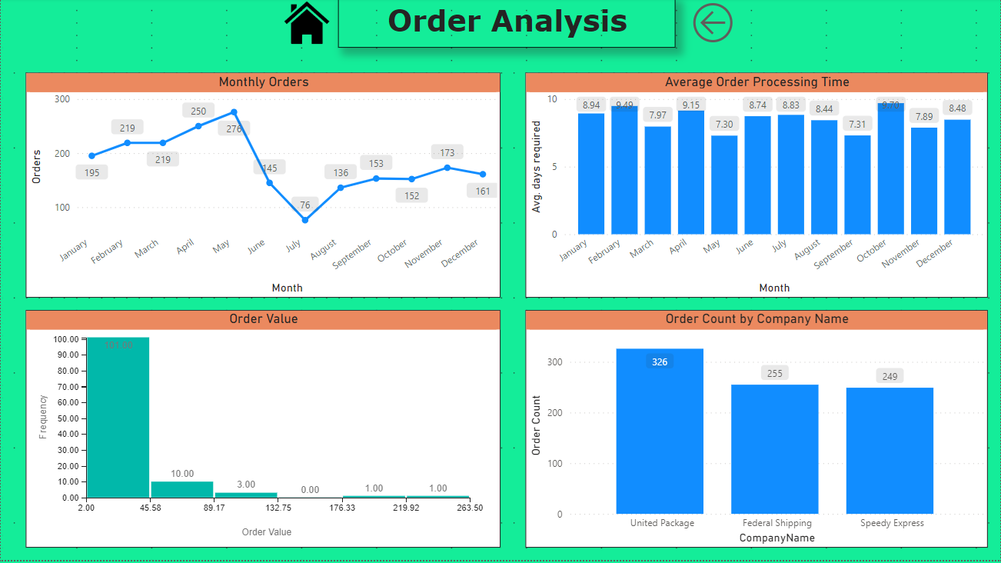

Slide 12
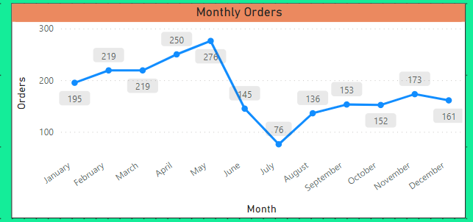
How does order volume change over time?
From this visualization, we can understand that from January to May orders increase and then decrease just like customer acquisition which indicates that when customers increase order increases and when customers decreases orders eventually decreases.

Slide 13
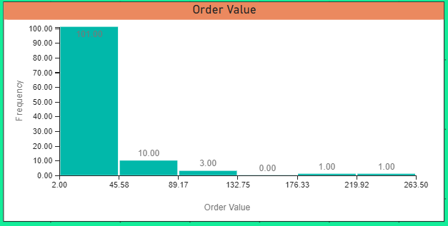
What is the distribution of order values?
From this visualization, we come to know that most of the order values lie between the price range of 2 to 45. The most expensive price range is from 219 to 263 which has only 1 product.

Slide 14
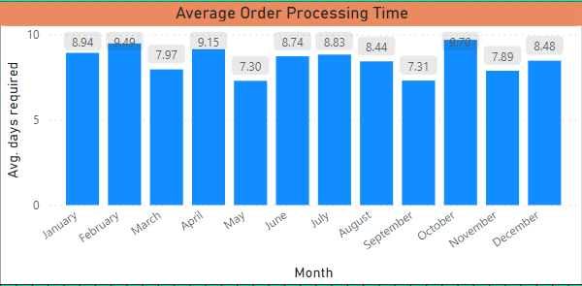
Can we visualize the average order processing time or shipping duration?
From the above visualization, we can see that the average order processing time for every month is nearly about same indicating there is no delay when the orders are more or less in shipping orders.

Slide 15
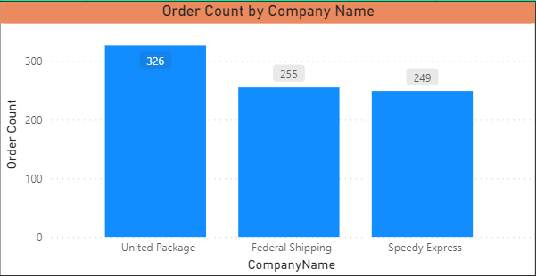
Can we find the Order Count each shipping company have done?
In this visualization, we find that the United Package company have delivered the most number of orders(326) followed by Federal Shipping and Speedy Express.

Slide 16
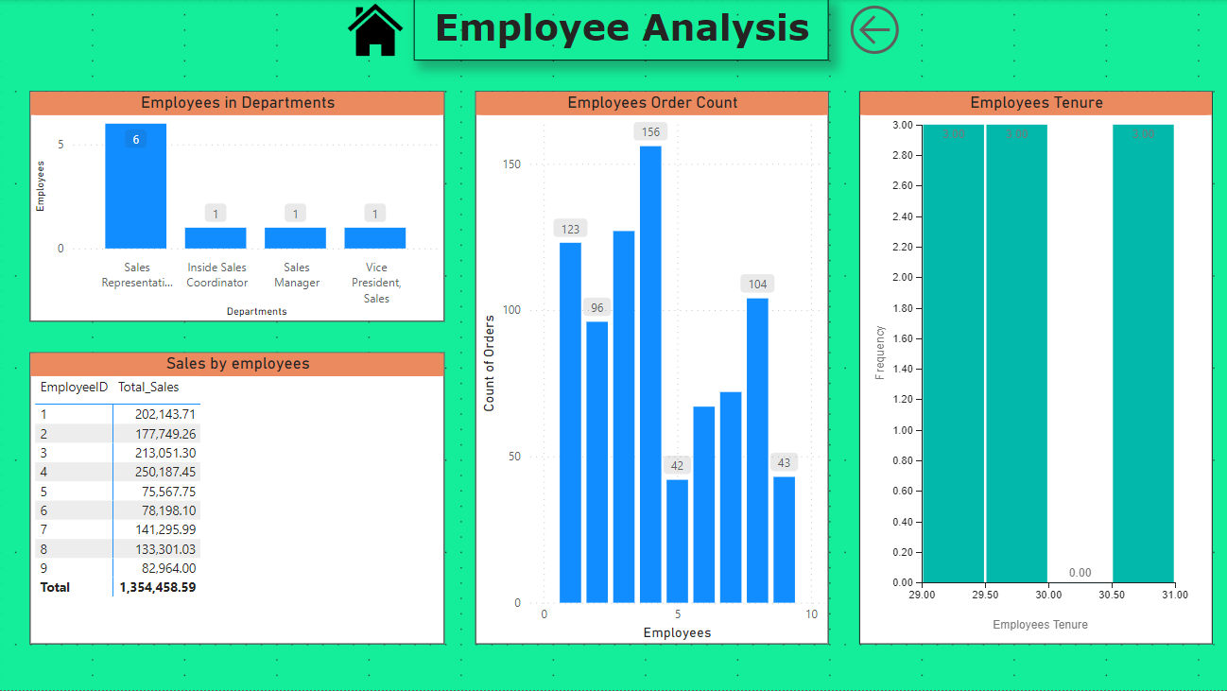

Slide 17
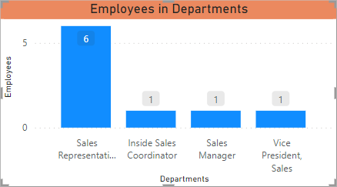
How does employee productivity vary across different departments or job roles?
From the above Visualization, we come to know that the company Focuses more on employees in the Sales Representative department than the others, as it has the most number of employees.

Slide 18
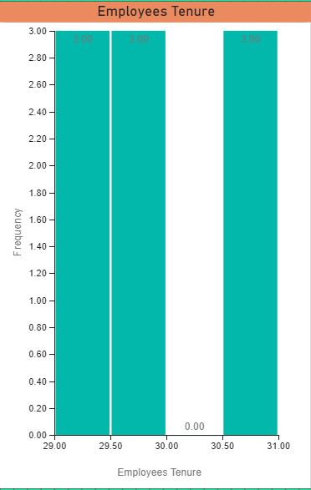
What is the distribution of employee tenure?
As we don’t have related data on which date the employees got separated from the company, we assume that they are still working for the company that is (2023). So we can analyse that most of the employees have completed 30 years for the company which shows loyalty towards the company.

Slide 19
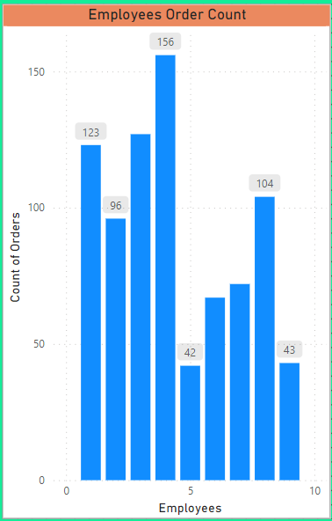
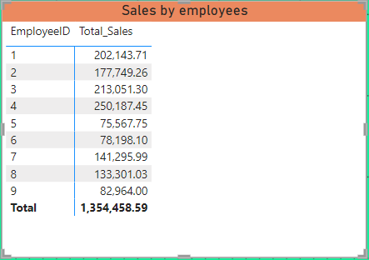
Can we visualize employee performance ratings or KPIs?
With the help of this visualization, we can analyse the order count and the sales done by the employees. We can say that employees who have Employee ID 4 have done more sales than the others. On the other hand, Employee ID 5 have the least sales done.

Slide 20
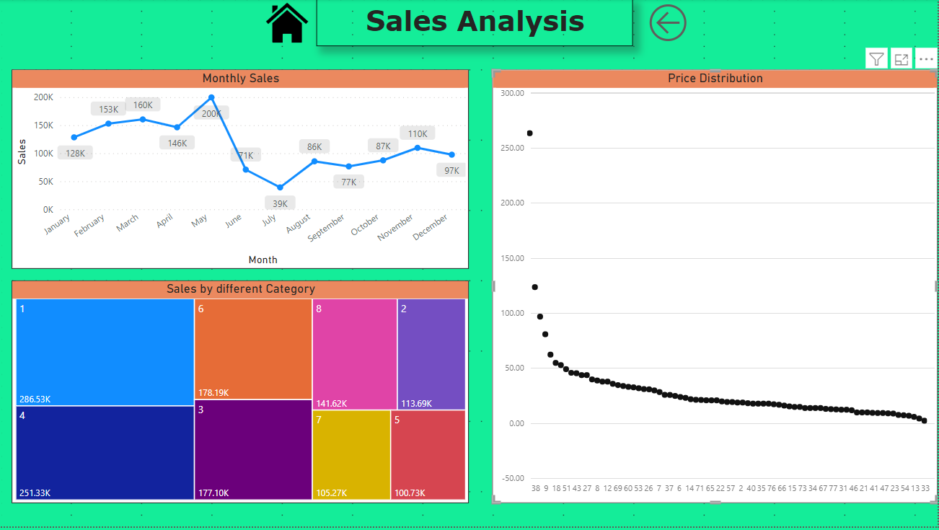

Slide 21
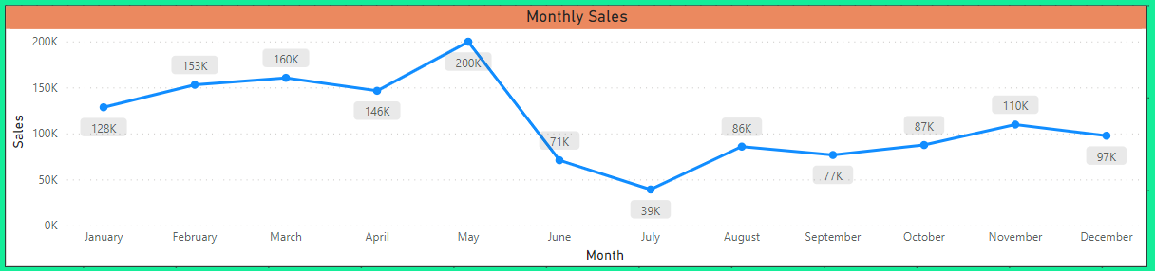
What is the distribution of product ratings or reviews?
How does Sales change over time?
From this visualization, we find that in the month of May, the sales were the most(200K) and the least sales in the month of July(39K). We can also analyse that in the first 5 months, the sales are promising but after that it decreases.
We don’t have relevant data in our data set, we require ratings and reviews of the customer’s related data.

Slide 22
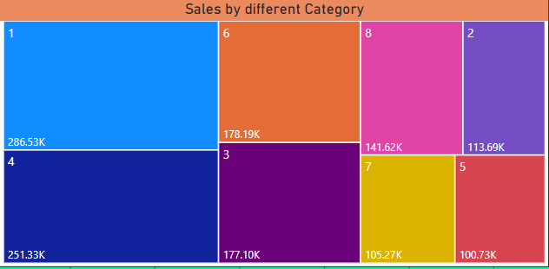
What is the distribution sales in different product category?
We can analyse that Category 1,2,6 and 3 are the leading categories in terms of sales which contribute half of the sales of products.

Slide 23
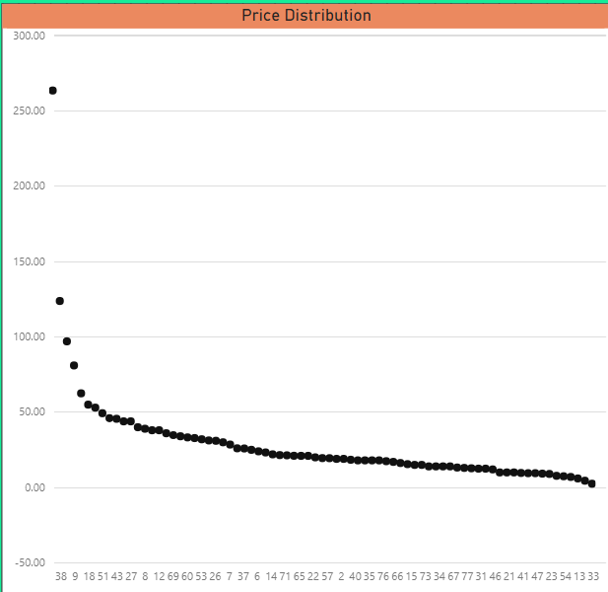
Can we visualize the pricing distribution of products?
From this visualization, we come to that there are 2 to 4 outliers in the pricing of the products. With the help of this, we can help the company to manage the price range of the products from the suppliers.

Slide 24
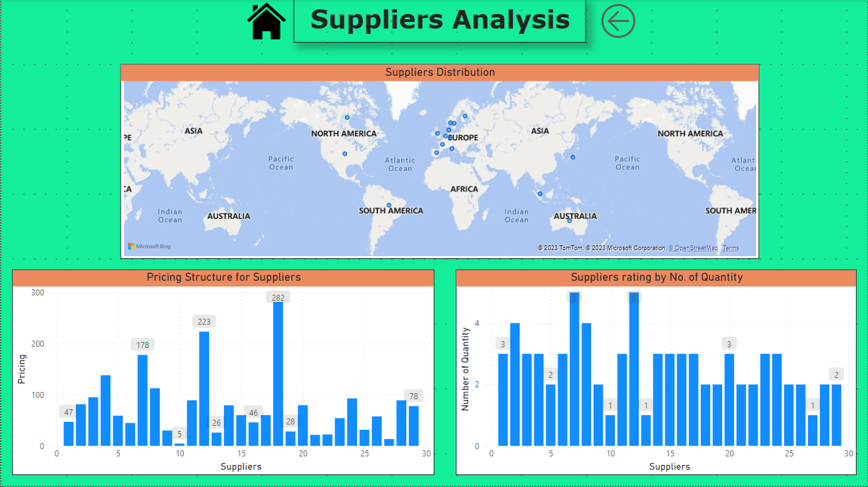

Slide 25
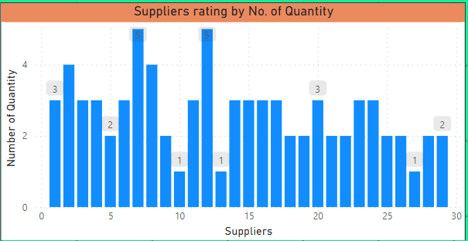
What is the distribution of supplier ratings or performance metrics?
We can analyse supplier ratings by the number of product quantities supplied by the supplier. From this visualization, we come to know that suppliers 7 and 12 have the most number of product quantities.

Slide 26
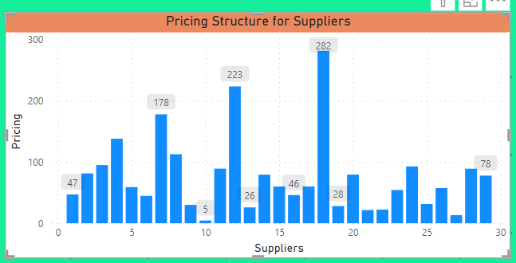
How does the cost or pricing structure vary across different suppliers?
From this visualization, we can see that leaving 3 product prices all other product prices are under 50. The most expensive product price is 282 followed by 223.

Slide 27
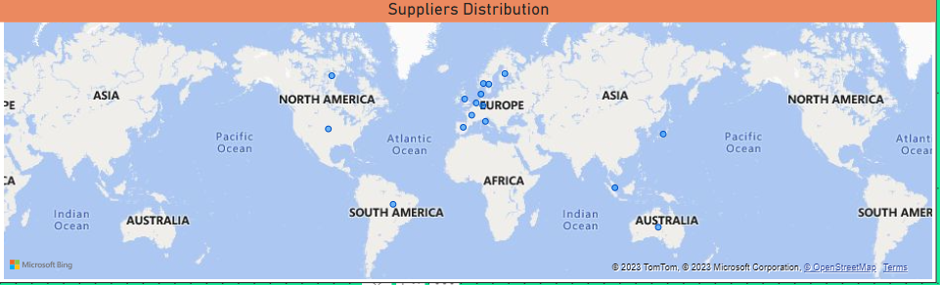
Can we visualize the geographical distribution of suppliers?
From this visualization, we can see that most suppliers are from Europe and the earlier visualization of customer’s geographical distribution we come to know that they are also from Europe which makes it easy for the company to distribute orders on or before delivery time.

Slide 28
EDA Problem Statement

Slide 29
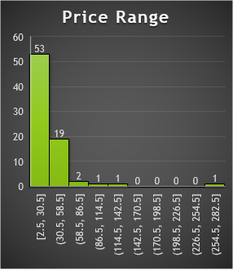
What are the key factors influencing customer retention or loyalty based on the dataset?
From this visualization, we can analyse the maximum product price range between 2.5 to 58.5 which is affordable for all the customer segments.
With the help of reorder analysis, we can say that many customers reorder our products which indicates the company provides good services.

Slide 30
How do customer preferences vary based on their location or demographics? Can we explore this through interactive visualizations?
We can see that Germany and France customers order the most products from the company whereas Italy and Mexico order the least.

Slide 31
Are there any interesting patterns or clusters in customer behavior that can be visualized to identify potential market segments?
We can see that most of our company’s customers are from Germany and France and Italy has the least number of customers.

Slide 32
Are there any specific product categories or SKUs that contribute significantly to order revenue? Can we identify them through visualizations?
From this visualization, we understand that Category 1 contributes the most in order revenue.

Slide 33
Are there any correlations between order size and customer demographics or product categories?
From the above visualization, we see that most of the order size lie between 0 to 2000.

Slide 34
How does order frequency vary across different customer segments?
As we don’t have a segment analysis we can distribute customers on the basics of the country they belong to. So, with the help of that, we can say that customers who belong to Germany order the most.

Slide 35
Are there any correlations between employee satisfaction levels and key performance indicators?
Employee satisfaction can treated as how they help customers, which eventually leads to an increase in sales. So, we can relate sales to employee satisfaction. So, with the help of this, we can say employee 4 has helped in increasing sales more than others.

Slide 36
How does employee turnover vary across different departments or job roles?
Sales Representative have a larger number of employee so their sales is also more than compared to other.

Slide 37
Can we identify any patterns or clusters in employee skill sets or qualifications through visualizations?
From this visualization, we can say that the company focuses more on the sales representative than the other departments as more employees are working in the sales representative department.

Slide 38
Are there any correlations between product attributes (e.g., size, color, features) and sales performance?
From this visualization, we can say that there is a correlation between product attributes and sales. Product attributes also consist of the names of the products so we can relate product names and sales performance. With the help of this correlation, we can analyse that many product sales are between 0 to 20000.

Slide 39
How does product demand fluctuate over different seasons or months?
From this visualization, we find that in the month of May the sales were the most(200K) and the least sales in the month of July(39K). We can also analyse that in the first 5 months, the sales are promising but after that it decreases.

Slide 40
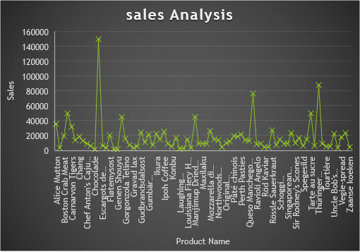
Can we identify any outliers or anomalies in product performance or sales using visualizations? How can this information be used for product optimization?
From this visualization, we understand that there are 5 products which can be considered as outliers in the sales analysis

Slide 41
Are there any correlations between supplier attributes (e.g., location, size, industry) and performance metrics (e.g., on-time delivery, product quality)?
Supplier attributes also include the company name. we can see that most companies have 3 to 2 products in their list.

Slide 42
How does supplier performance vary across different product categories or departments?
Supplier performance can be related to the number of categories they own. So, suppliers 7 and 12 have the most categories (5).

Slide 43
Can we identify any trends or patterns in supplier costs or pricing structures through visualizations? How can this information be used for procurement optimization?
From this visualization, we can identify that most of the supplier’s pricing structure is between 0 to 100 and some are above 100. so we can approach the suppliers and discuss optimising the high-range products such that many customers afford the products.

Slide 44
Conclusion
Here, we have come to the end of the capstone project with the topic name as Sales Analysis. I would like to share my experience while doing this project. I have learned the working of many tools like MySQL, Excel and Power BI.
How to find the insights of the problem statements and make charts which helps us to visualize the problem statements more effectively.
Making effective dashboards in Power BI helps the viewer to have a better understanding of the Problem statements.
With the help of MySQL, we learned how to write a query on a workbench and to get the desired records from the tables.
With the help of Excel, we learned how to make effective charts with the help of pivot tables and Excel functions.

